Slide 1
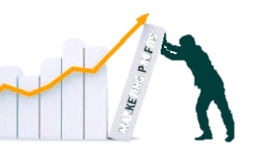
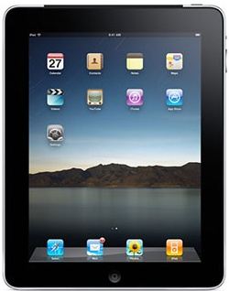
Value-Based Pricing
and Pricing Strategies
MBM6
Chapter 8
How Much Would You Pay for an iPad?
Chapter 8 Objectives
Value Pricing Strategies and Customer Value
Product Life-Cycle Pricing Strategies
Pricing Strategies and Profit Impact
https://www.youtube.com/watch?v=4t_MEO_la_k
Copyright Roger J. Best, 2012

Slide 2
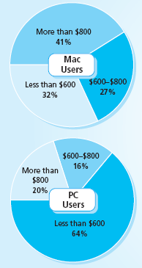
Value-Based Pricing
and Pricing Strategies
MBM6
Chapter 8
Pre-Launch
Price Research
How Much Would You Pay for an iPad?
Mac Users
41% would pay over $800.
32% would not pay
over $600.
PC Users
Only 20% would pay over $800.
64% would not pay over $600.
Copyright Roger J. Best, 2012

Slide 3
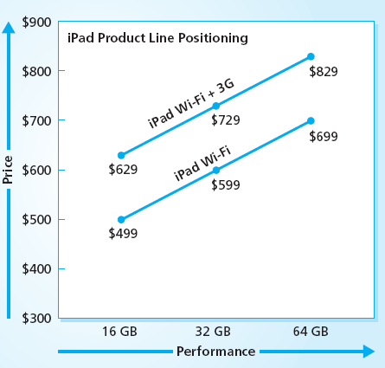
Apple iPad Pricing Strategy
MBM6
Chapter 8
Six price-performance iPads cover customer price preferences.
Copyright Roger J. Best, 2012

Slide 4
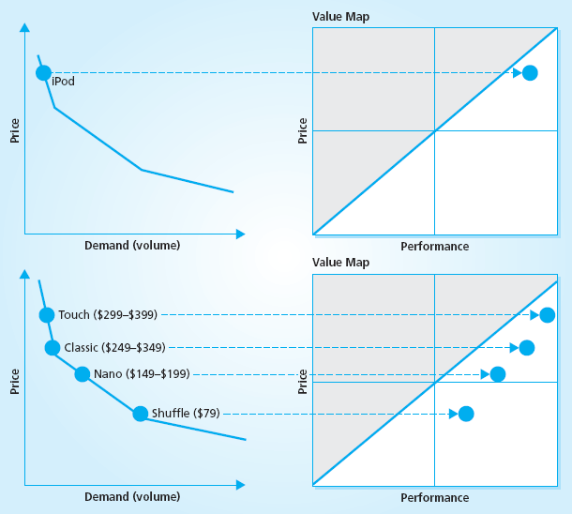
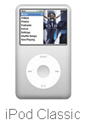



Apple iPod Pricing Strategy
MBM6
Chapter 8
Launch iPod with a high price and capture high end of the market.
Later add Touch at a higher price and Nano and Scuffle at lower prices.
Copyright Roger J. Best, 2012

Slide 5
Value-Based Pricing
and Pricing Strategies
MBM6
Chapter 8
Value Pricing Strategies
& Customer Value
This section focuses on different approaches to value pricing.
Copyright Roger J. Best, 2012

Slide 6
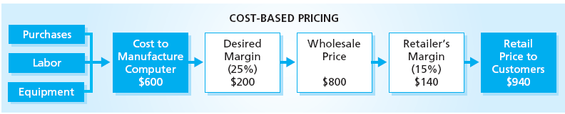
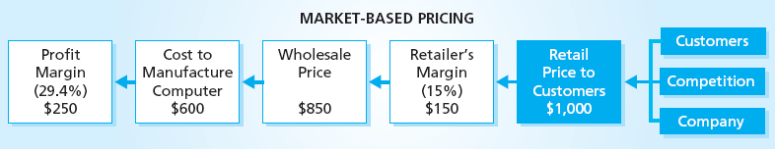
Cost-Based vs. Market-Based Pricing
MBM6
Chapter 8
Cost-Based Pricing: Starts with cost and desired margin and is marked up along the channel to a customer selling price of $940
Market-Based Pricing: Price is set based on competitive advantage and value ($1000) and discounts and costs deducted to arrive at a company margin.
Copyright Roger J. Best, 2012

Slide 7
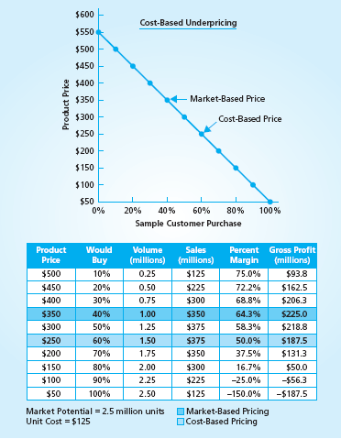

Under-Pricing a Digital Camera
MBM6
Chapter 8
Cost-Based Pricing With a unit cost of $125 and desired margin of 50% price was set at $250.
At that price 60% of the market would buy this product and produce a gross profit of $187.4 million.
Market-Based Pricing The price is set at $350 based on a market price that would produce the highest gross profit.
At that price 40% of the market would buy this product but it would produce a gross profit of $225 million.
Copyright Roger J. Best, 2012

Slide 8
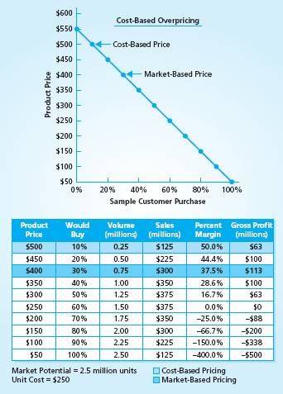
Over-Pricing a Digital Camera
MBM6
Chapter 8
Cost-Based Pricing
With a unit cost of $250 and desired margin of 50% price was set at $500.
At that price 10% of the market would buy this product and produce a gross profit of $63 million.
Market-Based Pricing
The price is set at $400 based on a market price that would produce the highest gross profit.
At that price 30% of the market would buy this product but it would produce a gross profit of $113 million.
Copyright Roger J. Best, 2012

Slide 9
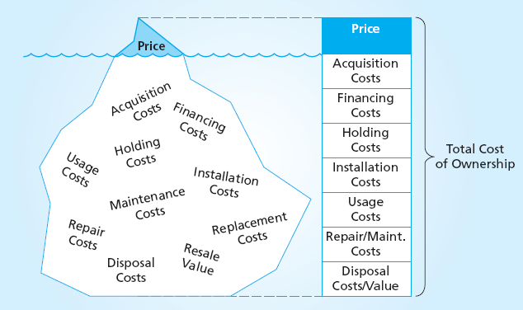
Cost of Car Ownership
MBM6
Chapter 8
Assume the price of a new Honda Civic is $20,000 and is owned for 3 years.
What are the ownership costs a buyer should consider in buying this car?
Copyright Roger J. Best, 2012

Slide 10
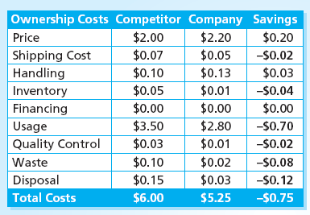
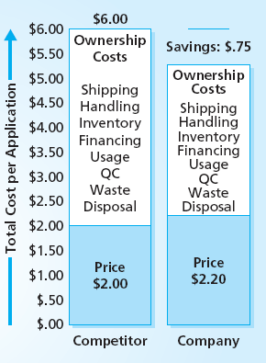
Value In-Use Pricing
Marketing Performance Tool 8.1
The company price its product 10% higher than their competitor.
Why would a customer pay more for this product?
Copyright Roger J. Best, 2012

Slide 11
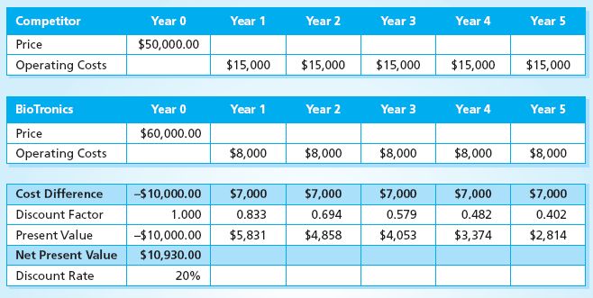
Life-Cycle Value Pricing
MBM6
Chapter 8
BioTronics charges $10,000 more for their bio-electronics product than their main competitor. The product life is 5 years. Why would a customer pay more for the BioTronics product?
Copyright Roger J. Best, 2012

Slide 12
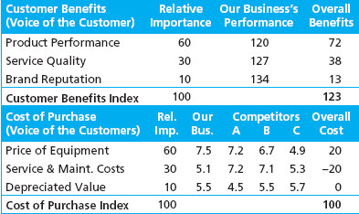
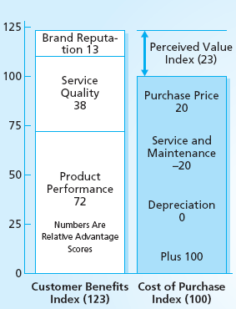
Why Pay More For This Product?
Marketing Performance Tool 8.2
Based on customer ratings of the business and
3 competitors, this business was rated:
20% higher on product performance
27% higher on service quality
34% higher on company reputation
20% higher in price of equipment
20% lower on service & maintenance.
Why would a customer pay 20% more for this company’s product?
Copyright Roger J. Best, 2012

Slide 13
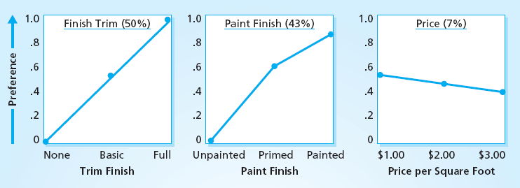
Price-Performance Trade-Offs
Marketing Performance Tool 8.3
Quality-Conscious Customer:
What are their performance drivers?
How important is price?
Why would a product priced at $3.00 per sq. ft. with full trim finish and painted out sell a product a $1.00 per sq. ft. that has a basic trim finish and is unpainted?
Copyright Roger J. Best, 2012

Slide 14
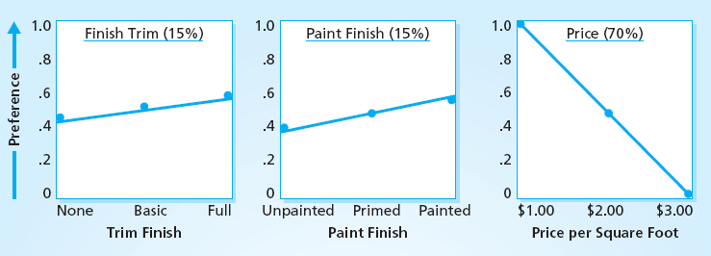
Price-Performance Trade-Offs
MBM6
Chapter 8
Price-Conscious Customer:
What are their performance drivers?
How important is price?
Why would a product priced at $3.00 per sq. ft. with full trim finish and painted not sell when a product a $1.00 per sq. ft. that has a basic trim finish and is unpainted would sell well?
Copyright Roger J. Best, 2012

Slide 15
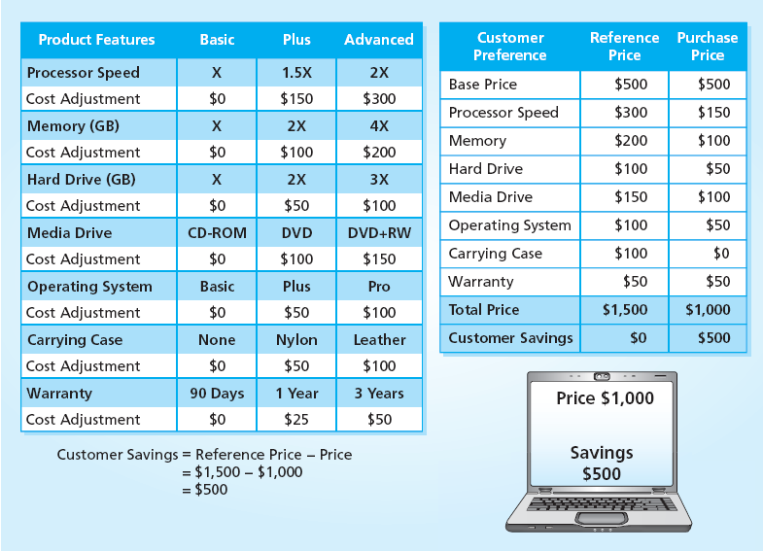
Customerization Value Pricing
MBM6
Chapter 8
*
* The Reference Price includes all advanced features .
Why would a customer feel this is a good value at a PC price of $1000?
Copyright Roger J. Best, 2012

Slide 16
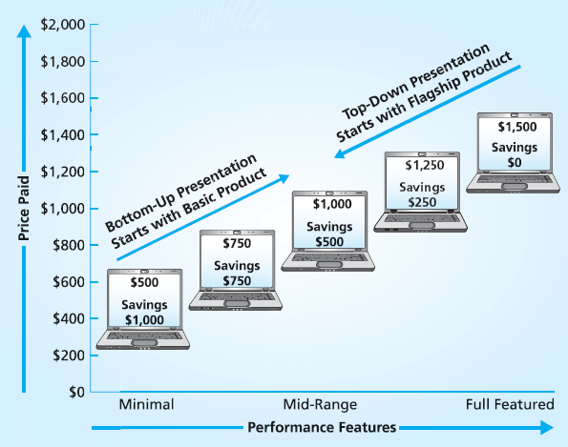
Top-Down Price Presentation
MBM6
Chapter 8
Research has shown that:
Top-Down presentation (highest priced to lowest) results in higher priced purchases.
Bottom-Up price presentation results in lower price purchases.
Why?
Copyright Roger J. Best, 2012

Slide 17
Value-Based Pricing
and Pricing Strategies
MBM6
Chapter 8
Product Life-Cycle
Pricing Strategies
This section focuses on different pricing strategies for different stages of the product life-cycle.
Copyright Roger J. Best, 2012

Slide 18
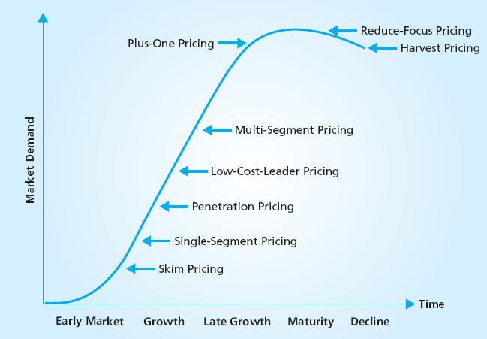
Starbucks Brand Strategy
MBM6
Chapter 8
Why is a skim pricing (p542) strategy often used during the early growth phase of the product life cycle?
Copyright Roger J. Best, 2012

Slide 19
Starbucks Brand Strategy
MBM6
Chapter 8
How is a Single Segment (p285) price strategy different than a Skim price (p285) strategy?
Copyright Roger J. Best, 2012

Slide 20
Starbucks Brand Strategy
MBM6
Chapter 8
Why would a company pursue a penetration (p286, low price) strategy during the early growth stage of the product life cycle?
Copyright Roger J. Best, 2012

Slide 21
Starbucks Brand Strategy
MBM6
Chapter 8
What is the difference between a Low-Cost Leader (p287) pricing strategy and Penetration pricing strategy?
Copyright Roger J. Best, 2012

Slide 22
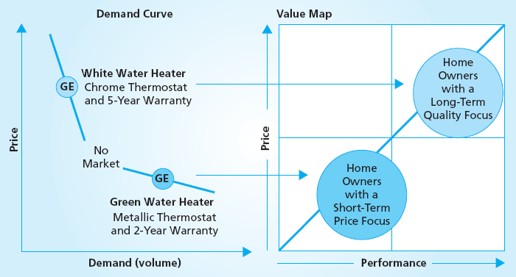
GE Multi-Segment Strategy
MBM6
Chapter 8
Penetration Price
Why would it be more profitable for GE to serve two segments with a Multi-Pricing strategy than one segment with a Penetration price strategy?
Copyright Roger J. Best, 2012

Slide 23
Starbucks Brand Strategy
MBM6
Chapter 8
Why is Plus-One pricing strategy important in late growth and mature markets?
Copyright Roger J. Best, 2012

Slide 24
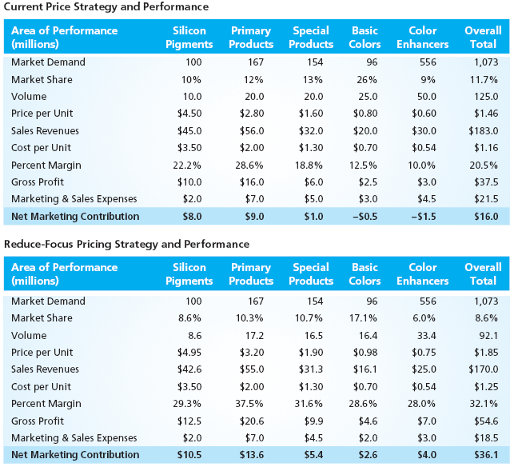
Reduced Price Strategy
MBM6
Chapter 8
Why would a Reduced Focus (p289) price improve profits while lowering sales?
How could NetFlix have used this strategy?
Copyright Roger J. Best, 2012

Slide 25
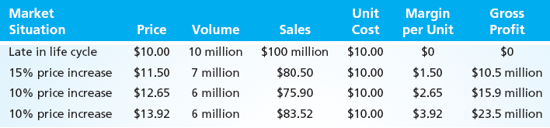
Harvest Pricing Strategy
MBM6
Chapter 8
Why is Harvest pricing (p290) most likely to be use in mature or declining markets?
Explain why many who raise prices with the intention of exiting a market find it more profitable to stay in the market?
Copyright Roger J. Best, 2012

Slide 26
Value-Based Pricing
and Pricing Strategies
MBM6
Chapter 8
Pricing Strategies
And Profit Impact
This section focuses on different approaches to value pricing.
Copyright Roger J. Best, 2012

Slide 27
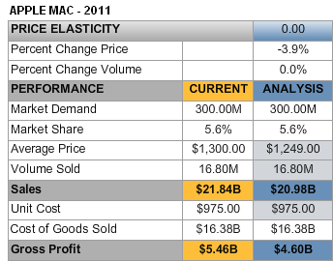
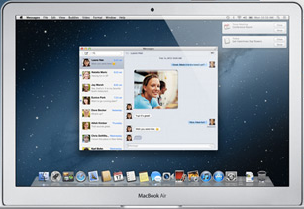
Profit Impact of Mac Price Decrease
Marketing Performance Tool 8.4
???
?
Current: In 2011 the Apple sold 16.8 million Macs at an average price of $1300. This produced $21.83 billion in sales and $5.46 billion in gross profit.
Analysis: If in 2012 Apple lowered the average price to $$1249, how many more Macs would they sell (best guess)? (1.249*16.8=$20.98B)
Copyright Roger J. Best, 2012

Slide 28
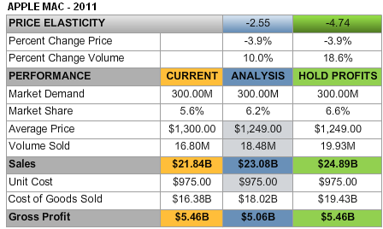
What If a Price Decrease to $1249
Yields a 10% Volume Increase?
MBM6
Chapter 8
Why did the Mac sales increase but the gross profits decrease?
Analysis: If in 2012 they lowered the average price to $1249 and volume increased by 10% (1.68 million units), sales would increase by over $1 billion but gross profits would decrease.$400 million.
Hold Profits: For this price decrease to just maintain current profits would require a volume of 19,93 million ( a 6.6% market share).
Copyright Roger J. Best, 2012

Slide 29
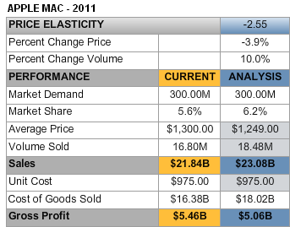
Mac Price Elasticity
MBM6
Chapter 8
Price Elasticity =
% Change Volume
% Change Price
10% Change Volume
-3.9 % Change Price
=
= -2.55
When the percent change in volume is greater than the
percent change in price, we have an elastic price.
Copyright Roger J. Best, 2012

Slide 30
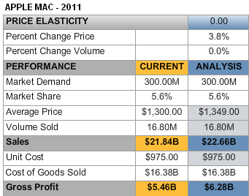
What About a Mac Price Increase?
MBM6
Chapter 8
???
?
Analysis: If in 2012 Apple raised the average price to $1349, how much would the Mac volume go down (best guess)? 22.6/$1.349=16.75M
Copyright Roger J. Best, 2012

Slide 31
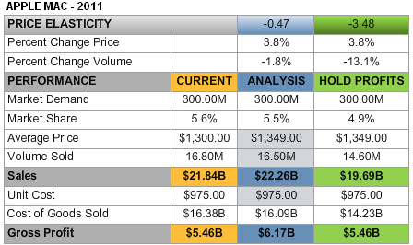
What If Price Was Increased to $1349
and Volume Decreased by 1.8%
MBM6
Chapter 8
Why did the Mac sales and gross increase?
Analysis: If Apple raised the average price to $1349 and volume increased by 300,000, sales gross profits would increase. Why?
Hold Profits: Apple could lower volume sold to 14.6 million and still maintain current profits. Any volume sold over 14.6 million would produce a higher gross profit.
Copyright Roger J. Best, 2012

Slide 32
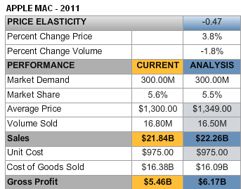
Mac Price Elasticity
MBM6
Chapter 8
Price Elasticity =
% Change Volume
% Change Price
-1.8% Change Volume
3.8 % Change Price
=
= -.47
When the percent change in volume is less than the
percent change in price, we have an inelastic price.
Copyright Roger J. Best, 2012

Slide 33
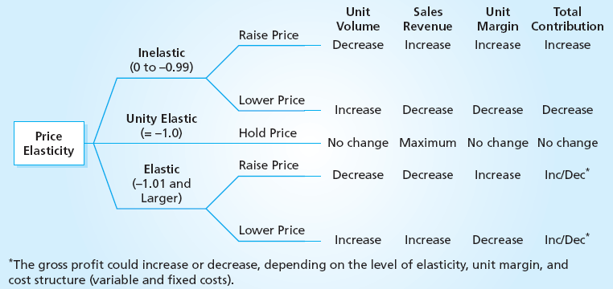
Price Elasticity and Profit Impact
MBM6
Chapter 8
Inelastic Prices: Never lower price when a price is inelastic. A lower price will result in lower sales and lower profits.
Elastic Prices: Use caution when lowering prices when prices are elastic. If percent margins are low, a lower price will increase sales but often result in lower profits.
Copyright Roger J. Best, 2012

Slide 34
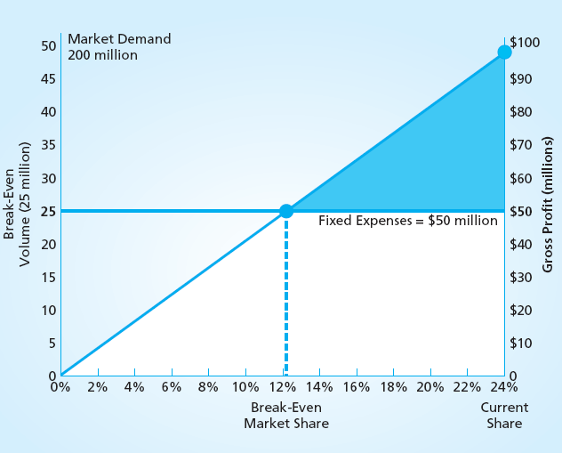
Breakeven Market Share
MBM6
Chapter 8
Breakeven Analysis
Volume where zero profits occur is 24 million units.
Breakeven Volume:
= Fixed Expenses
(Price – Unit Cost)
Breakeven Market Share:
= Breakeven Volume
Market Demand
Why is breakeven market share a better marketing profitability metric?
Copyright Roger J. Best, 2012

Slide 35
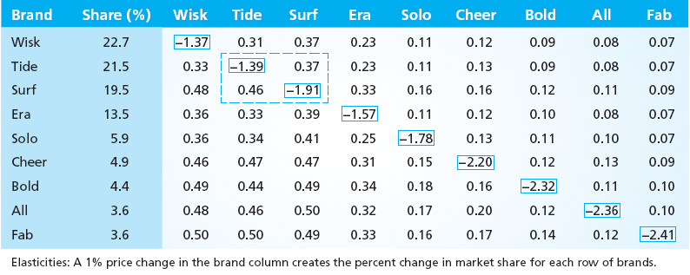

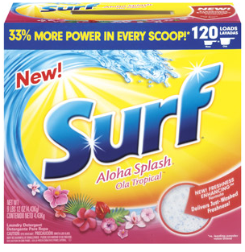
Product Line Price Elasticity’s
MBM6
Chapter 8
Why does price elasticity tend to increase with market share? (Note: the diagonals are brand price elasticity’s)
If Tide raised their price by 10%, the Tide volume would go down by 13.9% and the Surf volume would increase by 4.6%
Copyright Roger J. Best, 2012

